Slide 1
18-349: Introduction to Embedded Real-Time Systems
Lecture 7: Profiling and Optimization
Anthony Rowe
Electrical and Computer Engineering
Carnegie Mellon University

Slide 2
Lecture Overview
System Profiling
Speed
Size
Power
ARM Optimization

Slide 3

System Profiling
"If you can not measure it, you can not improve it.”
– Lord Kelvin
What can we improve?

Slide 4
System Profiling
Algorithm Efficiency
Big “O” notation for limit of functions
Code Speed
Measure execution time
Code Size
Number of bytes
Memory Consumed
Power Consumed

Slide 5
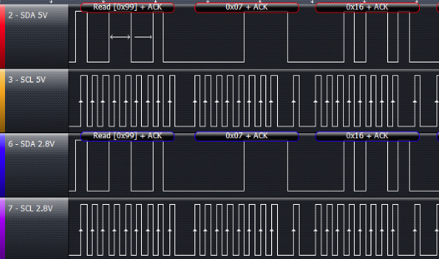
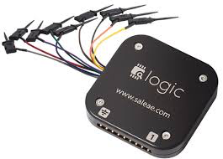
GPIO Timing
GPIO are often the lowest latency I/O

Slide 6
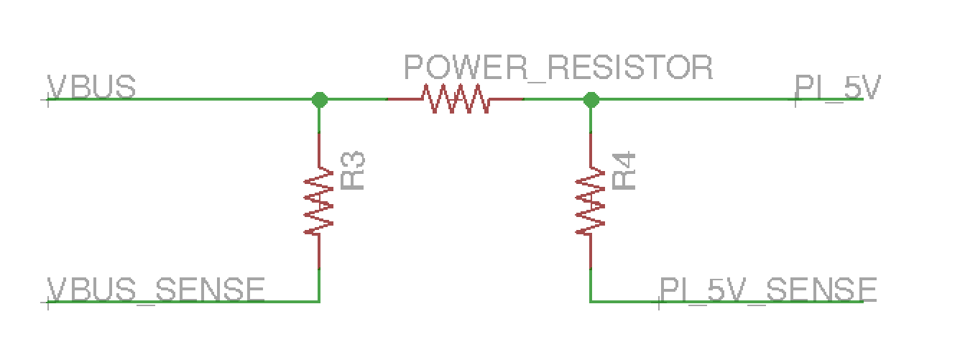
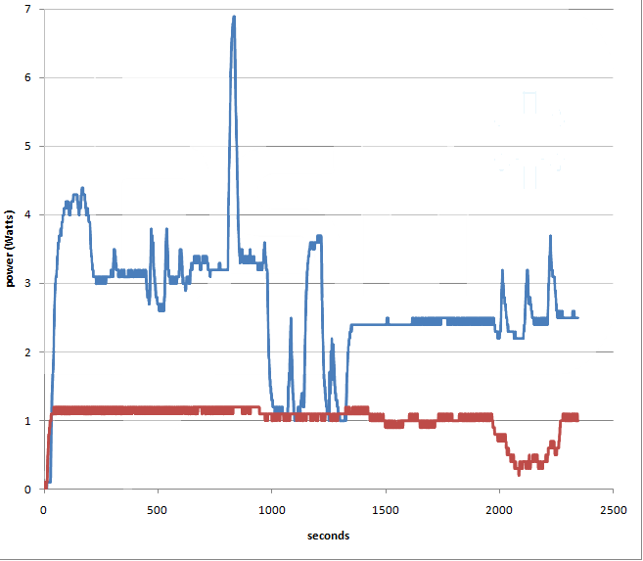
Energy Profile
RPi
~
O-scope

Slide 7
Deeper Profiling
Use timers to benchmark internal code segments
Get a Linux Runtime Version of SOME of your code
Port relevant algorithmic components to an existing OS on a less-constrained environment
Now you can use existing tools
Gprof
Valgrind

Slide 8
Gprof
Provides timing information for function call tree
Built into GNU Binutils
Instruments code at the start of function calls
Inserts mcount function
Sampling probes PC given OS interrupt calls
Requires an OS or at least profile interrupts
More information: http://docs.freebsd.org/44doc/psd/18.gprof/paper.pdf

Slide 9
Valgrind
Programming tool(s) for memory debugging, memory leak detection and profiling
Most common tool is Memcheck
Use of uninitialized memory
Read/writing freed memory
Read/write passed array bound or malloc
Memory Leaks
Many other tools
Massif (heap profiler)
Helgrind (checks race conditions in threads)
Cachegrind (cache profiler)
Callgrind (call graph analyser)
Exp-sgcheck (experimental stack and global memory tool)

Slide 10
Lab 1 Part A - Optimization
#define SIZE 500
int array1[SIZE],array2[SIZE];
void optimize_me(int array[SIZE]);
void unoptimized(int array[SIZE]);
void kernel_main(void)
{
. . .
// Start measuring ticks for optimized function
printk("+++++++Optimized Function+++++++\n");
tic();
optimize_me(array1);
timerValue = toc();
printk("%d\n",timerValue);
// Start measuring ticks for unoptimized function
printk("+++++++Unoptimized Function+++++++\n");
tic();
unoptimized(array2);
timerValue = toc();
printk("%d\n",timerValue);
...
// Check that arrays are equal…
}

Slide 11
Lab 1 Part B - Optimization
func2:
@ Function supports interworking.
@ args = 0, pretend = 0, frame = 8
@ frame_needed = 1, uses_anonymous_args = 0
@ link register save eliminated.
str fp, [sp, #-4]!
add fp, sp, #0
sub sp, sp, #12
str r0, [fp, #-8]
str r1, [fp, #-12]
ldr r2, [fp, #-12]
mov r3, r2
mov r3, r3, asl #2
add r3, r3, r2
mov r2, r3, asl #2
add r2, r3, r2
ldr r3, [fp, #-8]
add r3, r2, r3
mov r0, r3
sub sp, fp, #0
@ sp needed
ldr fp, [sp], #4
bx lr
.size func2, .-func2
.align 2
.global unoptimized
.type unoptimized, %function
How can we make this faster?
For the lab it needs to be 3x….
TA solution is more then 7.5x...

Slide 12
Optimization Overview
Code Optimization Techniques
Processor independent compiler optimizations
Common sub-expression elimination
Dead-code elimination
Induction variables
In-lining of functions
Loop unrolling
ARM specific optimization
Count-down loops
Register spilling
Efficient use of global variables
Space Optimization

Slide 13
Code Optimization
Embedded systems usually contain a few key functions that determine the system’s performance
By optimizing these functions, you can reduce the number of clock cycles required by a program, and reduce program’s power consumption
Several ways to optimize programs
Choose efficient algorithms and data structures
Write code that can be optimized by a compiler
Convert C code to assembly code
Code optimization can also involve optimizing the amount of memory used
Memory optimization techniques often (but not always) conflict with clock-cycle optimization techniques

Slide 14
Improving Program Performance
Compiler writers try to apply several standard optimizations
Do not always succeed
Have to ensure that the program will produce the same output for all cases
Optimizations based on specific architecture/implementation characteristics can be very helpful
How can one help?
Re­organize code to help compiler find opportunities for improvement

Slide 15
Processor-Independent Optimizations (1)
Common Sub-expression Elimination
Formally, “An occurrence of an expression E is called a common sub-expression if E was previously computed, and the values of variables in E have not changed since the previous computation.”
You can avoid re-computing the expression if we can use the previously computed one.
Benefit: less code to be executed
BEFORE
AFTER
b:
t6 = 4 * i
x = a[t6]
t7 = 4 * i
t8 = 4 * j
t9 = a[t8]
a[t7] = t9
t10 = 4 * j
a[t10] = x
goto b
b:
t6 = 4 * i
x = a[t6]
t8 = 4 * j
t9 = a[t8]
a[t6] = t9
a[t8] = x
goto b

Slide 16
Processor Independent Optimizations (2)
Dead-Code Elimination
If code is definitely not going to be executed during any run of a program, then it is called dead-code and can be removed
Example:
debug = 0;
...
if (debug){
print .....
}
You can help by using #ifdefs to tell the compiler about dead-code
It is often difficult for the compiler to identify dead-code itself

Slide 17
Processor Independent Optimizations (3)
Induction Variables and Strength Reduction
A variable X is called an induction variable of a loop L if every time the variable X changes value, it is incremented or decremented by some constant
When there are 2 or more induction variables in a loop, it may be possible to get rid of all but one
It is also frequently possible to perform strength reduction on induction variables
The strength of an instruction corresponds to its execution cost
Benefit: Fewer and less expensive operations
BEFORE
AFTER
j = 0
label_XXX
j = j + 1
t4 = 11 * j
t5 = a[t4]
if (t5 > v) goto label_XXX
t4 = 0
label_XXX
t4 += 11
t5 = a[t4]
if (t5 > v) goto label_XXX
Notes:
Strength reduction refers to the optimization where the multiplication involved in an induction variable (t4=11*j) is replaced by a lower cost instruction (addition; t4+=11)

Slide 18
Processor-Independent Optimizations (4)
Loop Unrolling
Doing multiple iterations of work in each iteration is called “loop unrolling”
Benefit: reduction in looping overheads and opportunity for more code opts.
Danger: increased code size and non­integral loop div.
Appropriate when loops are small
int checksum(int *data, int N)
{
int i, sum=0;
for(i=0;i<N;i++)
{
sum += *data++;
}
return sum;
}
int checksum(int *data, int N)
{
int i, sum=0;
for(i=0;i<N;i+=4)
{
sum += *data++;
sum += *data++;
sum += *data++;
sum += *data++;
}
return sum;
}
BEFORE
AFTER

Slide 19
Loop Unrolling
Original loop
0x00: MOV r3,#0 ; sum =0
0x04: MOV r2,#0 ; i= 0
0x08: CMP r2,r1 ; (i < N) ?
0x0c: BGE 0x20 ; go to 0x20 if i >= N
0x10: LDR r12,[r0],#4 ; r12 <- data++
0x14: ADD r3,r12,r3 ; sum = sum + r12
0x18: ADD r2,r2,#1 ; i=i+1
0x1c: B 0x8 ; jmp to 0x08
0x20: MOV r0,r3 ; sum = r3
0x24: MOV pc,r14 ; return
BEFORE
loop overhead
computed N times
0x00: MOV r3,#0 ; sum = 0
0x04: MOV r2,#0 ; i = 0
0x08: B 0x30 ; jmp to 0x30
0x0c: LDR r12,[r0],#4 ; r12 <- data++
0x10: ADD r3,r12,r3 ; sum = sum + r12
0x14: LDR r12,[r0],#4 ; r12 <- data++
0x18: ADD r3,r12,r3 ; sum = sum + r12
0x1c: LDR r12,[r0],#4 ; r12 <- data++
0x20: ADD r3,r12,r3 ; sum = sum + r12
0x24: LDR r12,[r0],#4 ; r12 <- data++
0x28: ADD r3,r12,r3 ; sum = sum + r12
0x2c: ADD r2,r2,#4 ; i = i + 4
0x30: CMP r2,r1 ; (i < N) ?
0x34: BLT 0xc ; go to 0x0c if i < N
0x38: MOV r0,r3 ; r0 <- sum
0x3c: MOV pc,r14 ; return
After unrolling
the loop 4 times
AFTER
loop overhead
computed N/4 times

Slide 20
Processor-Independent Compiler Optimizations (5)
In-lining of functions
Replacing a call to a function with the function's code is called “in-lining”
Benefit: reduction in procedure call overheads and opportunity for additional code optimizations
Danger: increased code size (possibly)
Appropriate when small and/or called
from a small number of sites
void t(int x, int y)
{
int a1=max(x,y);
int a2=max(x+1,y);
return max(a1+1,a2);
}
__inline int max(int a, int b)
{
int x;
x=(a>b ? a:b);
return x;
}
Notes:
? Is the ternary operator

Slide 21
Without Function Inlining
void t(int x, int y)
{
int a1=max(x,y);
int a2=max(x+1,y);
return max(a1+1,a2);
}
int max(int a, int b)
{
int x;
x=(a>b ? a:b);
return x;
}
max
$a
0x00: CMP r0,r1; (x > y) ?
0x04: BGT 0x0c; return if (x > y)
0x08: MOV r0,r1; else r0 <- y
0x0c: MOV pc,r14 return
t
0x10: STMFD r13!,{r4,r14}; save registers
0x14: MOV r2,r0; r2 <- x
0x18: MOV r3,r1; r3 <- y
0x1c: MOV r1,r3; r1 <- y
0x20: MOV r0,r2; r0 <- x
0x24: BL max ; r0 <- max(x,y)
0x28: MOV r4,r0; r4 <- a1
0x2c: MOV r1,r3; r1 <- y
0x30: ADD r0,r2,#1; r0 <- x+1
0x34: BL max ; r0 <- max(x+1,y)
0x38: MOV r1,r0 ; r1 <- a2
0x3c: ADD r0,r4,#1 ; r0 <- a1+1
0x40: LDMFD r13!,{r4,r14} ; restore
0x44: B max ;

Slide 22
With Function Inlining
void t(int x, int y)
{
int a1=max(x,y);
int a2=max(x+1,y);
return max(a1+1,a2);
}
__inline int max(int a, int b)
{
int x;
x=(a>b ? a:b);
return x;
}
0x00: CMP r0,r1 ; (x<= y) ?
0x04: BLE 0x10 ; jmp to 0x10 if true
0x08: MOV r2,r0 ; a1 <- x
0x0c: B 0x14 ; jmp to 0x14
0x10: MOV r2,r1 ; a1 <- y if x <= y
0x14: ADD r0,r0,#1; generate r0=x+1
0x18: CMP r0,r1 ; (x+1 > y) ?
0x1c: BGT 0x24 ;jmp to 0x24 if true
0x20: MOV r0,r1 ; r0 <- y
0x24: ADD r1,r2,#1 ; r1 <- a1+1
0x28: CMP r1,r0 ; (a1+1 <= a2) ?
0x2c: BLE 0x34 ; jmp to 0x34 if true
0x30: MOV r0,r1 ; else r0 <- a1+1
0x34: MOV pc,r14

Slide 23
Negative Instruction-Cache Effects
Negative instruction-cache effects
- Loop unrolling and function in-lining can cause performance degradation in systems with caches
int checksum(int *data, int N)
{
int i;
for(i=N;i>=0;i--)
{
;
}
return sum;
}
0x0000000c: LDR r3,[r2],#4
0x00000010: ADD r0,r3,r0
0x00000014: SUB r1,r1,#1
0x00000018: CMP r1,#0
0x0000001c: BGE 0xc
sum += *data++
0x0000000C
Before unrolling the loop
0x00000010
0x00000014
0x00000018
0x0000001C
instruction cache

Slide 24
Negative Instruction-Cache Effects (contd)
0x00000008: LDR r3,[r0],#4
0x0000000c: ADD r2,r3,r2
0x00000010: LDR r3,[r0],#4
0x00000014: ADD r2,r3,r2
0x00000018: LDR r3,[r0],#4
0x0000001c: ADD r2,r3,r2
0x00000020: LDR r3,[r0],#4
0x00000024: ADD r2,r3,r2
0x00000028: SUB r1,r1,#4
0x0000002c: CMP r1,#0
0x00000030: BGE 0x8
After unrolling the loop
int checksum(int *data, int N)
{
int i;
for(i=N;i>=0;i-=4)
{
}
return sum;
}
sum += *data++;
sum += *data++;
sum += *data++;
sum += *data++;
instruction cache

Slide 25
ARM-Specific Code-Optimization Techniques
Often, it is important to understand the architecture's implementation in order to effectively optimize code
One example of this is the ARM barrel shifter
Can convert Y * Constant into series of adds and shifts
Y * 9 = Y * 8 + Y * 1
Assume R1 holds Y and R2 will hold the result
ADD R2, R1, R1, LSL #3 ; LSL #3 is same as * by 8
Use of conditional execution of instructions can reduce the code size as well as reduce the number of execution cycles

Slide 26
Writing Efficient C for ARM Processors (1)
Use loops that count down to zero, instead of counting upwards
Example
Counting upwards needs an ADD instruction, a CMP to check if index less than 64, and a conditional branch if index is less than 64
Counting downwards needs a SUBS instruction (which sets the CPSR flags), and a conditional branch instruction BGE to handle the end of the looping
int checksum(int *data)
{
unsigned i;
int sum=0;
for(i=0;i<64;i++)
sum += *data++;
return sum;
}
int checksum (int *data)
{
unsigned i;
int sum=0;
for(i=63;i >= 0;i--)
sum += *data++;
return sum;
}
Count-up loop
Count-down loop

Slide 27
Count-Down Loops (Example)
int checksum_v1(int *data)
{
unsigned i;
int sum=0;
for(i=0;i<64;i++)
sum += *data++;
return sum;
}
int checksum_v2(int *data)
{
unsigned i;
int sum=0;
for(i=63;i >= 0;i--)
sum += *data++;
return sum;
}
MOV r2, r0; r2=data
MOV r0, #0; sum=0
MOV r1, #0; i=0
L1 LDR r3,[r2],#4; r3=*data++
ADD r1, r1, #1; i=i+1
CMP r1, 0x40; cmp r1, 64
ADD r0, r3, r0; sum +=r3
BCC L1; if i < 64, goto L1
MOV pc, lr; return sum
MOV r2, r0; r2=data
MOV r0, #0; sum=0
MOV r1, #0x3f; i=63
L1 LDR r3,[r2],#4; r3=*data++
ADD r0, r3, r0; sum +=r3
SUBS r1, r1, #1; i--, set flags
BGE L1; if i >= 0, goto L1
MOV pc, lr; return sum

Slide 28
Writing Efficient C for ARM Processors (2)
These are things you can keep in mind, rather than expecting the compiler to do all the work for you
ARM processors uses 32-bit data types in their data processing instructions
If you use types like char, the compiler has to add extra code to check/ensure that the value does not exceed 255
Example
void t3(void)
{
char c;
int x=0;
for(c=0;c<63;c++)
x++;
}
void t4(void)
{
int c;
int x=0;
for(c=0;c<63;c++)
x++;
}
MOV r0,#0; x=0
MOV r1,#0; c=0
L1 CMP r1,#0x3f; cmp c with 63
BCS L2; if c>= 63, goto L2
ADD r0,r0,#1; x++;
ADD r1,r1,#1; c++
AND r1,r1,#0xff; c=(char) r1
B L1; branch to L1
L2 MOV pc,r14

Slide 29
Writing Efficient C for ARM Processors (3)
ARM does not have a divide instruction
Divisions are implemented by calling software routines in C library
Can take between 20-100 cycles
In many cases, it might be possible to avoid divisions and/or remainder operation
Example: Circular Buffers (assuming increment <= size)
start=(start+increment) % size
start+= increment;
if (start >= size)
start -= size;
start
Notes:
If you cannot avoid a division, try to arrange the numerator and denominator to be unsigned integers

Slide 30
Writing Efficient C for ARM Processors (4)
Efficiently using global variables: Global variables are stored in memory, load and store instructions are typically used to access the variable when they are used or modified
Register accesses are more efficient than memory accesses
In some cases a global variable is used frequently, it may be better to store it in a local variable
Example
int f(void);
int g(void);
int errs;
void test_v1(void)
{
errs += f();
errs += g();
}
int f(void);
int g(void);
int errs;
void test_v2(void)
{
int local_errs=errs;
local_errs += f();
local_errs += g();
errs=local_errs;
}

Slide 31
Efficient Use of Global Variables
test_v1
0x00: STMFD r13!,{r4,r14} ; save registers
0x04: BL f ; compute f()
0x08: LDR r4,0x84 ; r4 <- address of errs
0x0c: LDR r1,[r4,#0] ; r1 <- errs
0x10: ADD r0,r0,r1 ; r1 <- r1 + r0
0x14: STR r0,[r4,#0] ; store r1 at mem loc address of errs
0x18: BL g ; compute g()
0x1c: LDR r1,[r4,#0] ; r1 <- errs
0x20: ADD r0,r0,r1
0x24: STR r0,[r4,#0] ; store r0 in errs
0x28: LDMFD r13!,{r4,pc} ; exit from function
test_v2
0x00: STMFD r13!,{r3-r5,r14} ; save registers
0x04: LDR r5,0x84 ; r5 <- address of errs
0x08: LDR r4,[r5,#0] ; r4 = local_errs = errs
0x0c: BL f ; compute f()
0x10: ADD r4,r0,r4 ; r4 = r4 + f()
0x14: BL g ; compute g()
0x18: ADD r0,r0,r4 ; r0 = r0 + r4;
0x1c: STR r0,[r5,#0] ; store r0 at mem loc address of errs
0x20: LDMFD r13!,{r3-r5,pc} ; exit from function

Slide 32
Writing Efficient C for ARM Processors (5)
Local variables are typically stored in registers
In some cases, local variables need to be stored in memory
Example – when the address of a local variable is taken
If a local variable is stored in memory, load and store are used to access the variable
Example
int f(int *a);
int g(int b);
void test_v1(void)
{
int i=0;
f(&i);
i += g(i);
i += g(i);
/* lots of access to i */
return i;
}
int f(int *a);
int g(int b);
void test_v2(void)
{
int dummy=0, i;
f(&dummy);
i = dummy;
i += g(i);
i += g(i);
/* lots of access to i */
return i;
}
Notes:
Here we are using the address of i which might make it store i in memory rather then a register since you can’t pass a pointer to a register…

Slide 33
Writing Efficient C for ARM Processors (6)
Avoid register spilling
When the number of local variables in use in a function exceeds the number of registers available
Causes the compiler to place certain variables in memory
You should limit the number of live variables in a function
Subdividing large functions into multiple small functions may help (keep in mind that there you increase the function call overhead)
Use the register keyword to tell the compiler which variables have to be stored in registers in case of register spilling

Slide 34
Optimizing Function Calls
Can the compiler optimize multiple calls to the same function?
Example: Will the compiler convert
Not always, the function square can have side-effects
If the function does not have any side-effects and is defined in the same file as the test function, then the compiler can optimize two calls to square into a single call to square
void test(int x)
return(square(x*x) + square(x*x));
void test(int x)
return(2*square(x*x));
?
into
int square(int x)
{
counter++; /* counter is a global variable */
return(x*x);
}

Slide 35
Writing Efficient C for ARM Processors (7)
Pure functions: Function whose output depends only upon the input parameters (and not the value of any other global variables) and do not have any side-effects
Can tell a compiler that a function is a pure function by using the keyword __pure in the declaration of the function
This allows the compiler to optimize calls to pure functions regardless of where the function is defined
Example:
__pure int square(int x);
int test(int x)
{
return (square(x*x) + square(x*x));
}
__pure int square(int x);
int test(int x)
{
return (2*square(x*x));
}

Slide 36
Optimization for Code Size – Optimizing Structures
Which of the two structures would be better?
struct
{
char a;
int b;
char c;
short d;
}
struct
{
char a;
char c;
short d;
int b;
}
12 bytes
8 bytes
Notes:
Talk about __packed directive to squish padding out. Lowers footprint but makes performance worse because cpu expects alignment and uses several byte-by-byte operations to get the data out

Slide 37
More Space Optimization
Can use the __packed key word to instruct the compiler to remove all padding
Packed structures are slow and inefficient to access
ARM Compiler emulates unaligned load and store by using several aligned accesses and using several byte-by-byte operations to get the data
Use __packed only if space is more important than speed and you cannot reduce padding by rearrangement
__packed struct
{
char a;
int b;
char c;
short d;
}
8 bytes
Notes:
Talk about __packed directive to squish padding out. Lowers footprint but makes performance worse because cpu expects alignment and uses several byte-by-byte operations to get the data out

Slide 38
Summary
Quick SWI / PC Detour
System Profiling
Speed
Size
Power
ARM Optimization

Slide 39
Linking Outline
Linking
What happens during linking?
How library functions get resolved by the linker?
Different kinds of linking
Executable & Linkable Format
ELF header description
Description of the sections of an ELF file
Loading an executable file into memory

Slide 40
Program Translation
square.c
main.c
Compiler
Compiler
Assembly
Assembly
Obj Library
Assembler
Assembler
Object
Linker
Object
Executable
Loader
Memory
Source : D. Patterson,J. Hennessey Computer Organization & Design

Slide 41
Linkers
Compilers and assemblers generate re-locatable object files
References to external symbols are not resolved
Compilers generate object files in which code starts at address 0
Cannot execute a compiler-produced object file
Executable files are created from individual object files and libraries through the linking process
Linker performs two tasks
Symbol resolution: Object files define and reference symbols, linker tries to resolve each symbol reference with one symbol definition
Relocation: Linker tries to relocate code and data from different object files so that different sections start at different addresses and all the references are updated

Slide 42
Example: Compiling main.c and square.c
int counter=3;
int tmp;
static int sum(int x, int y);
extern int square(int x);
int main()
{
int x=5, y=10;
int a, b;
tmp=sum(x,y);
a=square(x);
b=square(y);
tmp=sum(a,b);
return;
}
int sum(int x, int y)
{
int result;
result=x+y;
return result;
}
main.c
00000000 <sum>:
0: add r0, r0, r1 ; sum=x+y
4: bx lr ; return
00000008 <main>:
8: push {r4, r5, lr} ;save registers
c: sub sp, sp, #4 ; sp <- sp- 0x4
10: mov r0, #5 ; 0x5 ; x=5;
14: mov r1, #10 ; 0xa ; y=10
18: bl 0 <sum> ; compute sum(x,y)
1c : ldr r5, [pc, #48] ; r5 <= &tmp (54)
20: str r0, [r5] ; tmp=r0=sum(x,y)
24: mov r0, #5 ; x=5;
28: bl 0 <square> ; compute square(5)
2c: mov r4, r0 ; r4=r0= 25;
30: mov r0, #10 ; 0xa ; r0=10;
34: bl 0 <square> ; compute square(10)
38: mov r1, r0 ; r1=100;
3c: mov r0, r4 ; r0=r4=25
40: bl 0 <sum> ; compute sum(25, 100)
44: str r0, [r5] ; tmp = r0 = 125;
48: add sp, sp, #4 ; sp <= sp + 4
4c: pop {r4, r5, lr} ; restore registers
50: bx lr ; jump back
54: .word 0x00000000
00000000 <counter>:
0: .word 0x00000003 ; address 0x00 of data section contains 3
main.o
extern int counter;
int square(int x)
{
int result;
if(counter >= 0)
result=x*x;
else
result=0;
counter--;
return result;
}
square.c
compiler
compiler
0: ldr r3, [pc, #32] ; 28 <square+0x28>
4: ldr r2, [r3]
8: cmp r2, #0 ; 0x0
c: movlt r0, #0 ; 0x0
10: mulge r3, r0, r0
14: movge r0, r3
18: sub r2, r2, #1 ; 0x1
1c: ldr r3, [pc, #4] ; 28 <square+0x28>
20: str r2, [r3]
24: bx lr
28: 00000000 .word 0x00000000
square.o

Slide 43
Example: After Linking main.o and square.o
00008338 <sum>:
8338: add r0, r0, r1
833c: bx lr 00008340 <main>:
8340: push {r4, r5, lr}
8344: sub sp, sp, #4 ; 0x4
8348: mov r0, #5 ; 0x5
834c: mov r1, #10 ; 0xa
8350: bl 8338 <sum>
8354: ldr r5, [pc, #48]; r5 <= 0x0001056c = &tmp
8358: str r0, [r5] ; *0x0001056c = tmp = 15
835c: mov r0, #5 ; 0x5
8360: bl 8390 <square> ;
8364: mov r4, r0
8368: mov r0, #10 ; 0xa
836c: bl 8390 <square>
8370: mov r1, r0
8374: mov r0, r4
8378: bl 8338 <sum>
837c: str r0, [r5] ; *0x0001056c = tmp = 125
8380: add sp, sp, #4 ;
8384: pop {r4, r5, lr}
8388: bx lr
838c: .word 0x0001056c
00008390 <square>:
8390: ldr r3, [pc, #32] ; r3 = &counter (83b8)
8394 ldr r2, [r3] ; r2 = counter
8398 cmp r2, #0 ; 0x0 ; counter > 0 ?
839c: movlt r0, #0 ; 0x0 ; if(counter < 0) then r0<=0x0
83a0: mulge r3, r0, r0 ; else r3 = r0*r0
83a4: movge r0, r3 ; else r0 = r3 =r0 * r0
83a8: sub r2, r2, #1 ; counter--
83ac: ldr r3, [pc, #4] ; r3 = 0x00010564 = &counter (83b8)
83b0: str r2, [r3] ; counter = r2 = counter-1
83b4: bx lr ; return back
83b8: .word 0x00010564
00010564 <counter>:
10564: .word 0x00000003
.bss
0001056c <tmp>:
1056c: .word 0x00000000
linker relocates the code to a different memory location
linker adds the actual address of
symbol square

Slide 44
Library Functions
What happens when the source files use library functions like printf, scanf, etc.?
Compiler produces a symbol (in the same way as the square function in the previous example) in the object file
Linker
Attempts to resolve these references by matching them to definitions found in other object files
If the symbol is not resolved, the linker searches for the symbol definition in library files
What are library files?
Collection of object files that provide related functionality
Example: The standard C library libc.a is a collection of object files printf.o, scanf.o, fprintf.o, fscanf.o…

Slide 45
Library Functions
How does the linker know where to find the library?
User defined libraries can be specified as a command line argument
The environment variable LD_LIBRARY_PATH holds the path that is searched to find the specific library
Linker does a search to see whether the symbol is defined in the specified libraries
The order in which this search is performed is determined by the order in which the libraries are specified
If the symbol is defined in more than one library, the first library in the path is selected
Linker then extracts the specific .o file that defines the symbol in the library and processes this .o file with all the other object files
If the symbol is not defined in any of the library, linker throws an error

Slide 46
Kinds of Linking Models
Different kinds of linking models
Static: Set of object files, system libraries and library archives are statically bound, references are resolved, and a self-contained executable file is created
Problem: If multiple programs are running on the processor simultaneously, and they require some common library module (say, printf.o), multiple copies of this common module are included in the executable file and loaded into memory (waste of memory!)
Dynamic: Set of object files, libraries, system shared resources and other shared libraries are linked together to create an executable file
When this executable is loaded, other shared resources and dynamic libraries must be made available in the system for the program to run successfully
If multiple programs running on a processor need the same object module, only one copy of the module needs to be loaded in the memory

Slide 47
Dynamic Linking
Dynamically linked executable or shared object undergoes final linking when
Loaded into memory by a program loader
An executable or shared object to be linked dynamically might
List one or more shared objects (shared libraries) with which it should be linked
Other advantages of dynamic linking
Updating of libraries
The size on disk of an executable that uses dynamically linked modules may be less than its size in memory (during run-time)
Why?

Slide 48
Kinds of Object Files
Three main types of object files
Re-locatable file: Code and data suitable for linking with other object files to create an executable or a shared object file
Executable file: Program suitable for execution
Shared object file (also called “Dynamically linked library”): Special type of re-locatable object file that can be loaded into memory and linked dynamically
First, the linker may process it with other re-locatable and shared object files to create another object file
Second, the dynamic linker combines it with an executable file and other shared objects to create a process image
Compilers and assemblers generate re-locatable object files
Linkers generate executable object files

Slide 49
Executable and Linking Format (ELF)
Object files need to be in a specific format to facilitate linking and loading
Executable and Linkable Format (ELF) is the popular format of an object file
Supported by many vendors and tools
Diverse processors, multiple data encodings and multiple classes of machines
ELF specifies the layout of the object files and not the contents of code or data
ELF object files consist of
ELF Header
Beginning of ELF file
Holds a roadmap of file’s organization
How to interpret the file, independent of the processor
Program header table
Tells the system how to create a process image
Files used to build a process image (execute a program) must have a
program header table
Re-locatable files do not need one
Sections
Object file information for the linking view
Instructions, data, symbol table, relocation information, etc.

Slide 50
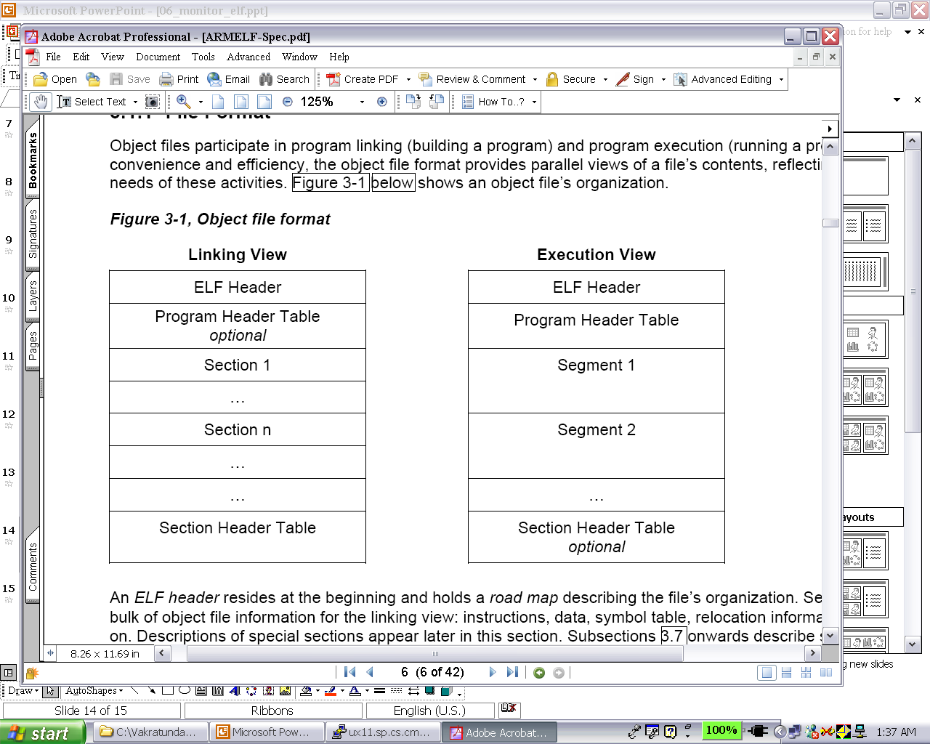
Linking & Execution Views

Slide 51
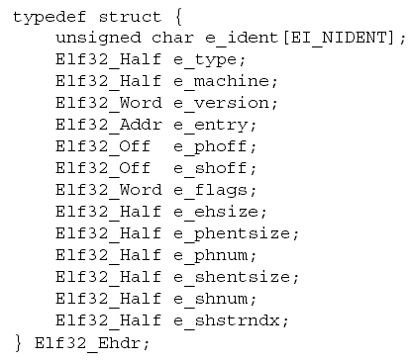
ELF Execution View

Slide 52
ELF Header
All ELF files contain a header in the beginning of the file
Determines whether the file is an ELF file, whether it is in big/little endian format, the target processor, offsets to the program header table and/or section header table…
Format of the ELF header
#define EI_NIDENT 16
typedef struct {
unsigned char e_ident[EI_NIDENT]; // file info (object file or not)
Elf32_Half e_type; // type of file (relocatable, executable, etc.)
Elf32_Half e_machine; // target processor (Intel x86, ARM, SPARC etc.)
Elf32_Word e_version; / version # (to allow for future versions of ELF)
Elf32_Addr e_entry; // program entry point (0 if no entry point)
Elf32_Off e_phoff; // offset of program header (in bytes)
Elf32_Off e_shoff; // offset of section header table
Elf32_Word e_flags; // processor-specific flags
Elf32_Half e_ehsize; // ELF header’s size
Elf32_Half e_phentsize; // entry size in pgm header tbl
Elf32_Half e_phnum; // # of entries in pgm header
Elf32_Half e_shentsize; // entry size in sec header tbl
Elf32_Half e_shnum; // # of entries in sec header tbl
Elf32_Half e_shstrndx; // sec header tbl index of str tbl
} Elf32_Ehdr;
See Section 3.2 of ARM ELF Specification document

Slide 53
ELF Sections
Relocatable files must have a section header table
Locations and size of sections are described by the section header table
ELF header
.text
.rodata
.data
.bss
.symtab
Sections
.rel.text
.rel.data
.debug
.line
.strtab
Section header table
Source: “Computer Systems: A Programmer’s Perspective”, R. E. Bryant and D. O’Hallaron

Slide 54
Description of Various Sections
.text: program instructions and literal data
.rodata: Read-only data such as the format strings in printf statements
.data: initialized global data
.bss: un-initialized global data (set to zero when program image is created)
This section does not occupy any space in the object file
.symtab: this section holds the symbol table information
All global variables and functions that are defined and referenced in the program
.rel.text: list of locations in the .text section that will need to be modified when linker combines this object files with others
.rel.data: relocation information for any global variables that are referenced or defined in a module
.debug: debugging information (present only if code is compiled to produce debug information)
.line: mapping between line numbers in C program and machine code instructions (present only if code is compiled to produce debug information)
.strtab: string table for symbols defined in .symtab and .debug sections

Slide 55
Executable Object Files
0
ELF header
Maps file sections to runtime memory segments
Segment header table
.init
Read-only memory segment
(code segment)
.text
.rodata
.data
Read/write memory segment
(data segment)
.bss
.symtab
.debug
Symbol table and debugging info are not
loaded into memory
.line
Describes object file sections
.strtab
Section header table

Slide 56
ELF Program Header
Executable ELF files must have a program header table
The program header table is used to load the program (called “creating program image”)
Each segment has its own entry in the program header table
e_phnum in ELF Header holds the number of program header entries
All program header entries have the same size (e_phentsize in ELF header)
Program header entry for each segment
typedef struct {
Elf32_Word p_type; //type of segment – loadable, dll,...
Elf32_Off p_offset; //offset in bytes from the start of file
Elf32_Addr p_vaddr; //virtual address in memory of segment
Elf32_Addr p_paddr; //physical address in memory of segment
Elf32_Word p_filesz; //number of bytes in the file of the segment
Elf32_Word p_memsz; //number of bytes in memory of the process //image of the segment
Elf32_Word p_flags; //indicates whether segment is executable
Elf32_Word p_align; //alignment information
} Elf32_Phdr;
What happens if p_memsz > p_filesz?
The remaining bytes (p_memsz-p_filesz) are initialized with 0

Slide 57
Useful Tools
You can use many command line tools to parse ELF files
ARM provides readelf command line utility that can display information about an ELF file
You can disassemble ELF files, look at symbol table information, etc.
Example: readelf main.o
** ELF Header Information
File Name: main.c
Machine class: ELFCLASS32 (32-bit)
Data encoding: ELFDATA2MSB (Big endian)
Header version: EV_CURRENT (Current version)
File Type: ET_REL (Relocatable object) (1)
Machine: EM_ARM (ARM)
Header size: 52 bytes (0x34)
Program header entry size: 32 bytes (0x20)
Section header entry size: 40 bytes (0x28)
Program header entries: 0
Section header entries: 25
Program header offset: 0 (0x00000000)
Section header offset: 4512 (0x000011a0)
…and more

Slide 58
Useful Tools (contd.)
Look at the symbol table information in main.o
Example: nm main.o
D (global, initialized, data) counter
T (global text) main
U (global undefined) square
t (local, static, text) sum
C (global, uninitialized) tmp
You can also use other switches to print information on each segment, section, print relocation information …

